Slide 1

OOP
Object Oriented Programming
Lecture 2
Lecture 1

Slide 2
What we will cover in this course?
Abstratction
Inheritance
Encapsulation
Information hIDING
Aggregation
Association
Message Passing
Polymorphism (Binding, casting, OIverriding) and much more

Slide 3
What is OOP?
OOP stands for Object-Oriented Programming.
Procedural programming is about writing procedures or functions that perform operations on the data, while object-oriented programming is about creating objects that contain both data and functions.
Object-oriented programming has several advantages over procedural programming:
OOP is faster and easier to execute
OOP provides a clear structure for the programs
OOP helps to keep the C++ code DRY "Don't Repeat Yourself", and makes the code easier to maintain, modify and debug
OOP makes it possible to create full reusable applications with less code and shorter development time

Slide 4
Object-Orientation - Advantages
People think in terms of objects
OO models map to reality
Therefore, OO models are
easy to develop
easy to understand

Slide 5
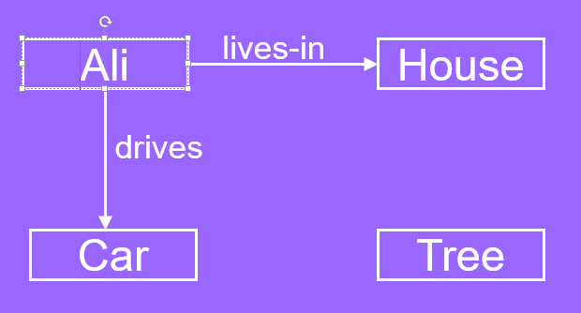
…Example – OO Model
Objects
Ali
House
Car
Tree
Interactions
Ali lives in the house
Ali drives the car

Slide 6
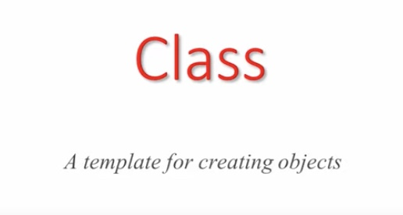

Slide 7
Classes and Objects
Objects are entities in the real world
Class is like a blueprint of these entities

Slide 8
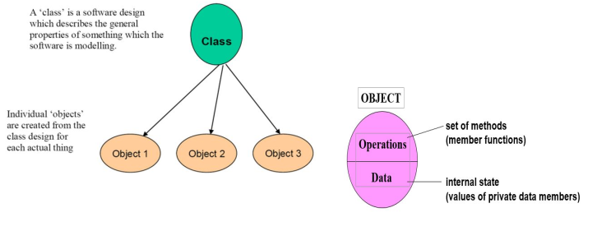
Class and Object

Slide 9
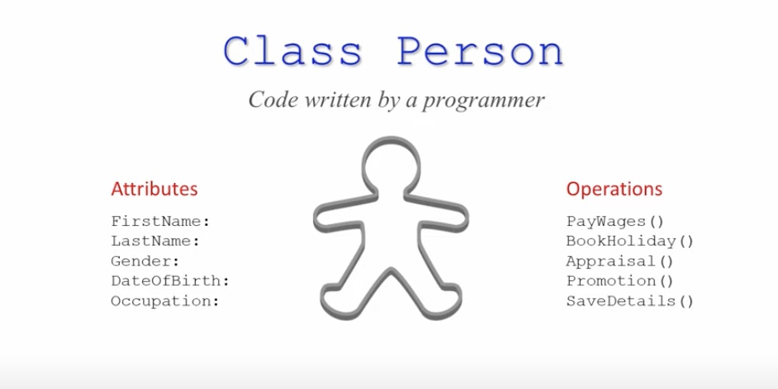
Notes:
Attributes/Fields/Properties

Slide 10
What is an Object?
An object is
Something tangible (Ali, Car)
Something that can be apprehended intellectually (Time, Date)
An object has
State (attributes)
Well-defined behaviour (operations)
Unique identity

Slide 11
Attributes describe the objects. They are sometimes referred to as fields because they contain data
These are coded within the class
Operations are actions that can be done to or performed by the object. They are sometimes refered to as behaviours but more commonly they are known as methods
Methods are programs within the class that are coded either as procedures or functions
A class is a template for creating objects
Notes:
Attributes/Fields/Properties

Slide 12
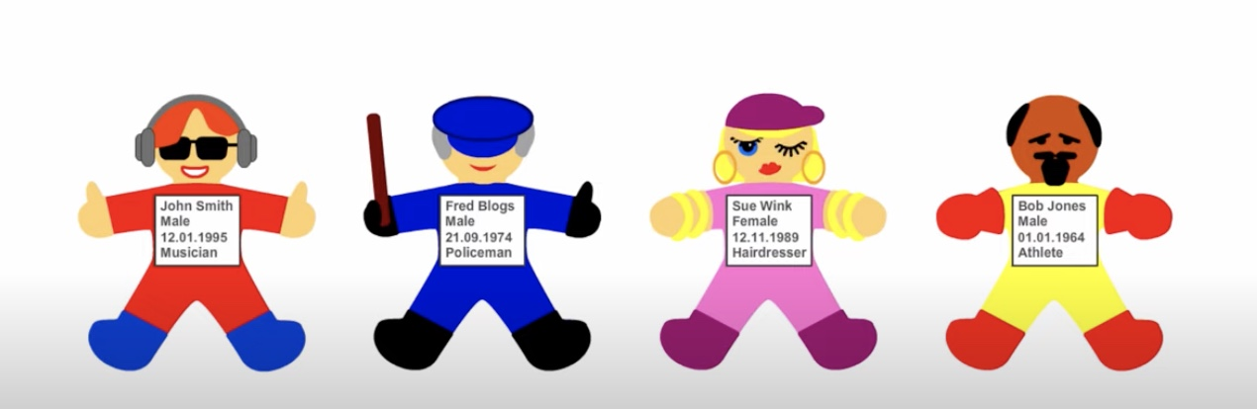

Slide 13
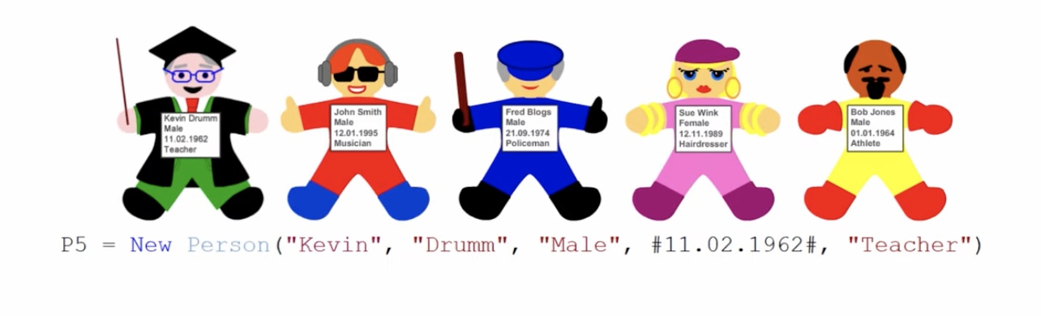
Notes:
new method -> constructor

Slide 14
Concept: An object has behaviors
An object contains both data and methods that manipulate that data
An object is active, not passive; it does things
An object is responsible for its own data
But: it can expose that data to other objects

Slide 15
Example – Ali is a Tangible Object
State (attributes)
Name
Age
Behavior (operations)
Walks
Eats
Identity
His name

Slide 16
Example – Car is a Tangible Object
State (attributes)
- Color
- Model
Behavior (operations)
- Accelerate - Start Car
- Change Gear
Identity
- Its registration number

Slide 17
Example – Practise
Smartphone ?
Tell me what are its attributes ?
Its behaviour?

Slide 18
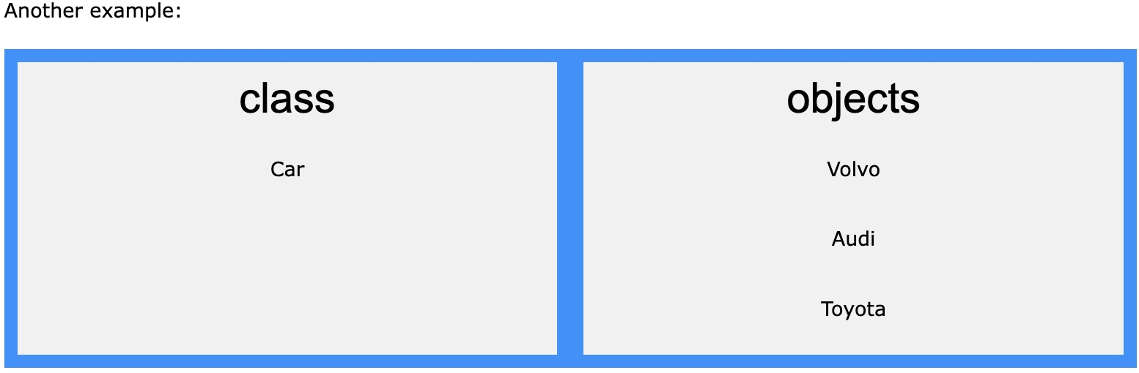
What are Classes and Objects?(Cont...)
So, a class is a template for objects, and an object is an instance of a class.
When the individual objects are created, they inherit all the variables and functions from the class.

Slide 19
Class and Object
A class is a data type that allows programmers to create objects. A class provides a definition for an object, describing an object’s attributes (data) and methods (operations).
An object is an instance of a class. With one class, you can have as many objects as required

Slide 20
Object Oriented Design
Library Management System
What are the main objects in this system?

Slide 21
Object Oriented Design
Library Management System
What are the main objects in this system?
Book
User

Slide 22
Object Oriented Design
Library Management System
What are the main objects in this system?
Book
User
What is the relevant data and for each, and what are the possible operations that can performed?

Slide 23
Object Oriented Design
Book
Data
Book name
Authors
Publisher
ISBN
Number of copies in library

Slide 24
Object Oriented Design
Book
Operations
Get the name of the book
Reduce number of copies in the library when one is issued
Increment the number of copies when one is returned

Slide 25
Object Oriented Design
Each object therefore consists of data and operations that can be performed on that data
The final program is a collection of interacting objects

Slide 26
Concepts of OOP
OOP is a programming style that is associated with the concept of Class, Objects, and various other concepts revolving around these two, like, Inheritence, polymorphism, Abstration, Encapsultaion, etc.
OOP aims to implement real world entities like inheritance, hiding, polymorphism, etc in programming.
The main aim of OOP is to bind together the data and the functions that operates on them so that no other part of code can access this data except that function.

Slide 27
Feature of OOP
Object
Classes
Real World Modeling
Reusability
Information Hiding
Polymorphism

Slide 28
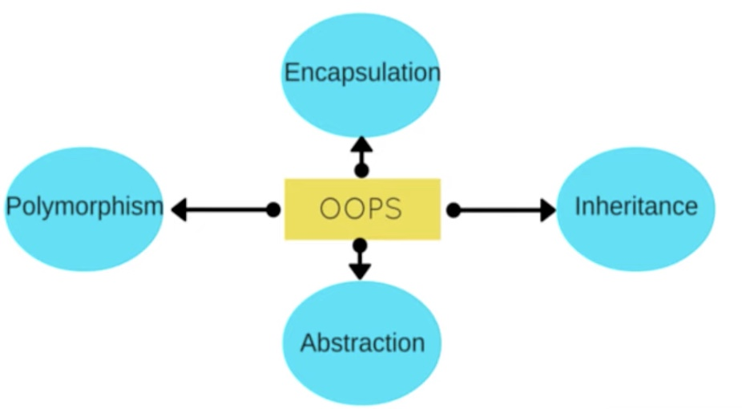
4 Main Pillers of OOP

Slide 29
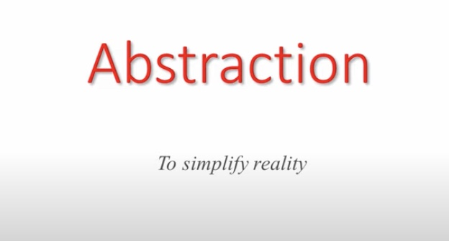

Slide 30
Data Abstraction
Abstraction means displaying only essential information and hiding the details.
Data abstraction refers to providing only essential information about the data to the outside world, hiding the background details or implementation.

Slide 31

Data Abstraction (Example 1)

Slide 32

Data Abstraction (Example 2)

Slide 33
Advantages of Information Hiding
Simplifies the model by hiding implementation details
Prevents accidental access
Prevents illegal access or manipulation

Slide 34


Slide 35
Defination
Encapsulation is the technique of bundling data (attributes) and methods (functions) that operate on that data into a single unit, usually a class. It restricts direct access to some of an object’s components and protects the integrity of the data by preventing external entities from modifying it directly.
Notes:
Also referred to as information hidinhg

Slide 36
Purpose:
Abstraction: Simplifies complexity by exposing only necessary features.
Encapsulation: Protects data and maintains integrity.

Slide 37


Slide 38
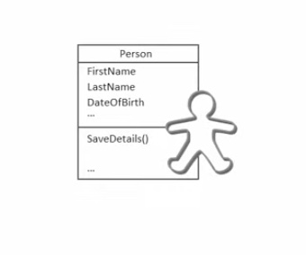

Slide 39
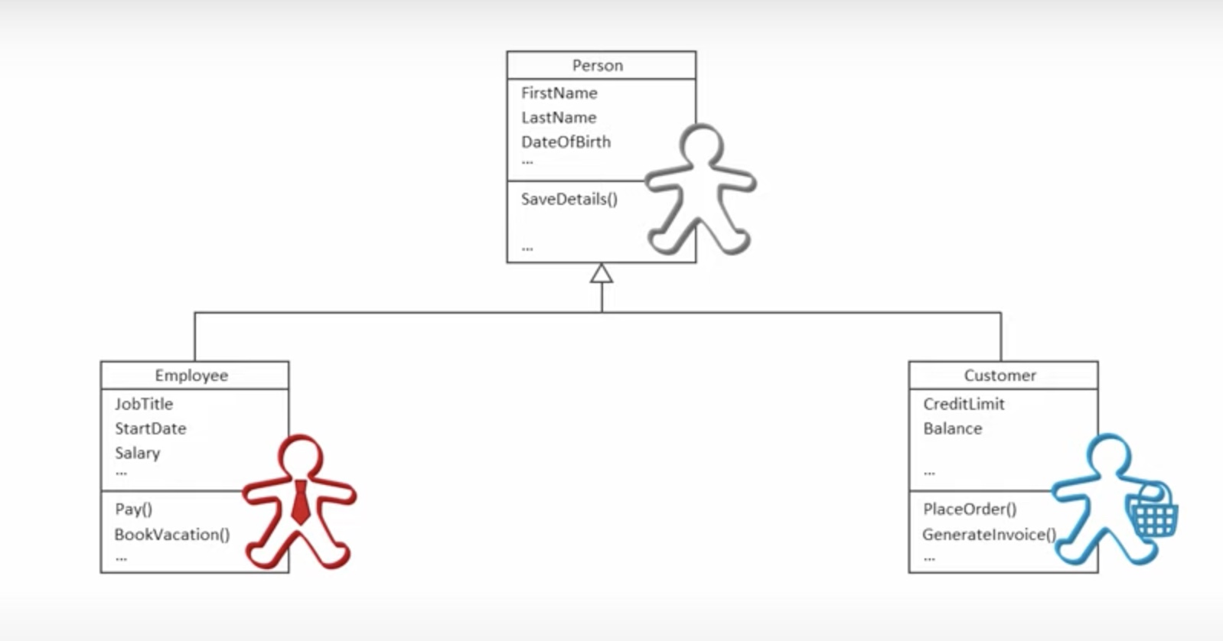

Slide 40
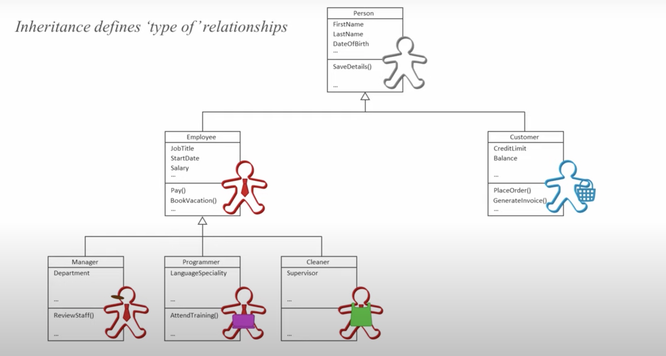
Notes:
The rroot class is the Base CLASS

Slide 41
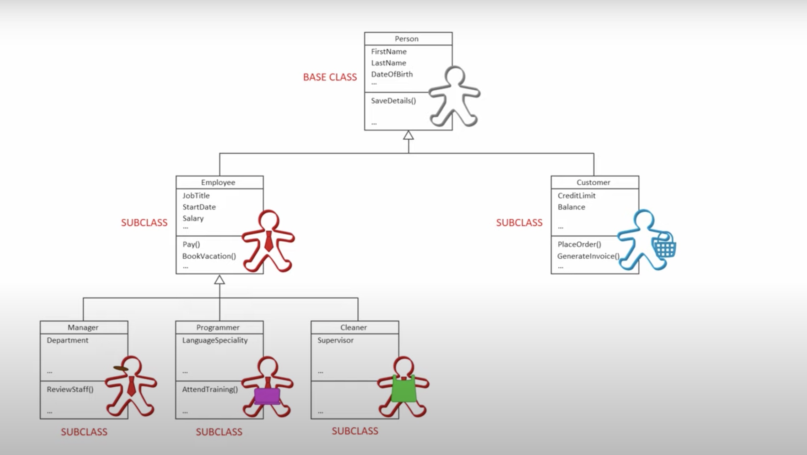
Notes:
The root class is the Base CLASS

Slide 42
Concept: Classes form a hierarchy
Classes are arranged in a treelike structure called a hierarchy
The class at the root is named Object
Every class, except Object, has a superclass
A class may have several ancestors, up to Object
When you define a class, you specify its superclass
If you don’t specify a superclass, Object is assumed
Every class may have one or more subclasses

Slide 43
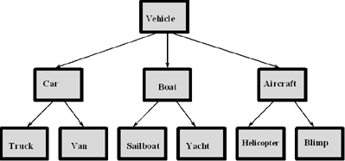
Example of (part of) a hierarchy
A class hierarchy for a vehicle rental company.

Slide 44
Exercise!
Scenario: A particular talent competition has 5 judges, each of whom awards a score between 0 to 10 to each performer. A performer’s final score is determined by dropping the lowest score received, then averaging the remaining 4 scores.
Task 1: Identify Attributes and functions.
Task 2: Procedural Programming approach?
Task 3: Object Oriented approach? (Model the problem: Identify class, objects)

Slide 45
End of Lecture

